Slide 1
Learning Human Emotion with
Natural Language Processing
MTE 546
Sebastian Fiorini, Vincent McLoughlin

Slide 2


Background
Objective: Train a computerized model to comprehend humour using Yelp reviews
Wanted to study high-level data-fusion
Modelling human emotion is a common application of neural networks
Yelp reviews are voted funny by the Yelp community
Large dataset available of 6.68 million reviews
Notes:
0.5 Minutes
Intelligently detect how lukjely a review is voted funny

Slide 3
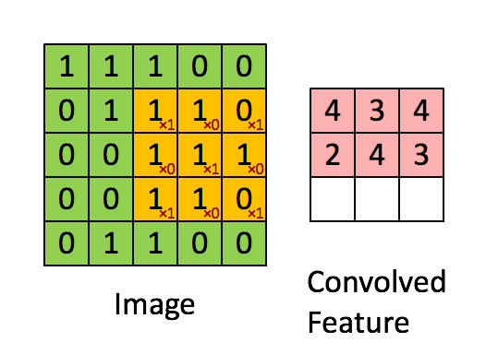
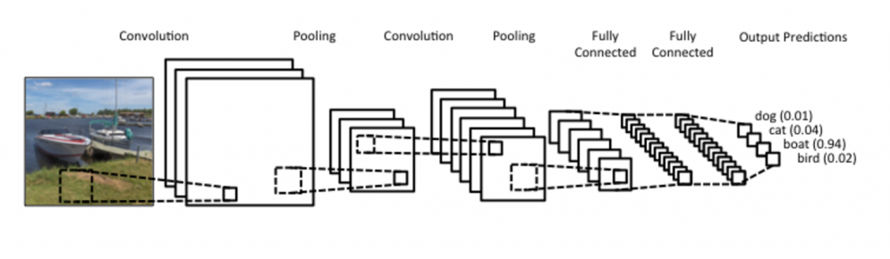
CNN (Convolutional Neural Network)
Traditional NNs connect every input to every output
CNNs convolve the inputs and map them to output
Results in localized connections
Good input to output sets are connected, bad ones aren’t
Convolution Process [1]
Matrix Convolution [2]
Notes:
Vincent

Slide 4
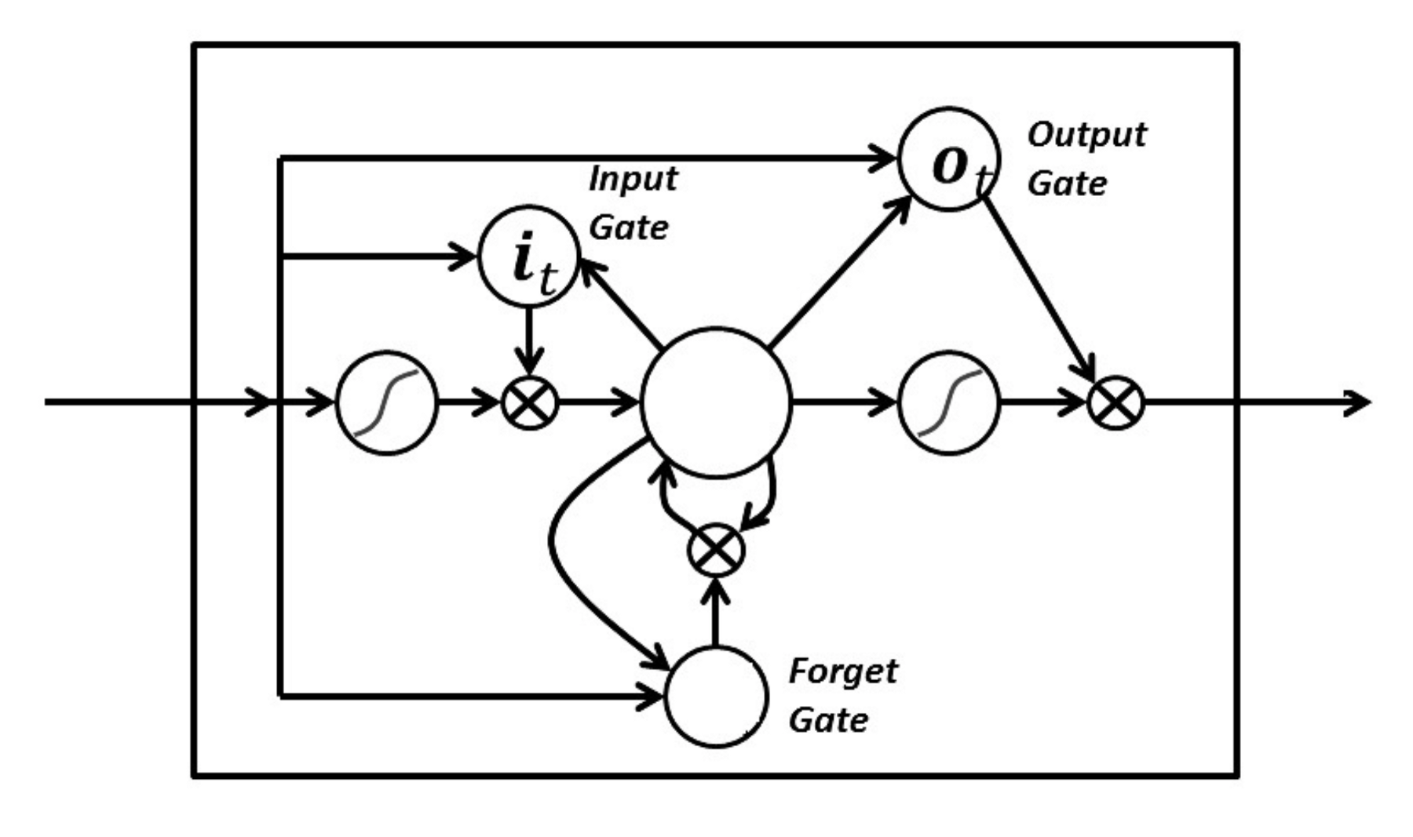
LSTM (Long Short Term Memory) Network
Network with memory of previous inputs [3]
Three gates, input, output, and forget
Forgets information it deems unimportant using its forget gate
LSTM Node [4]
Notes:
Vincent

Slide 5
Experimental Setup
Compared CNNs and LSTM performance with varied data configurations
Raw data, unchanged from the provided yelp data
roughly ~ 80/20 split
ground truth considered funny_vote >= 1
Split data, filtered from the provided yelp data
50/50 split of funny/not funny data
ground truth considered funny_vote >= 2
Notes:
Seb

Slide 6
Assumptions
All reviews voted ‘funny’ were ranked equally funny, even if some marked ‘funny’ higher than others
Used a word vocabulary of 10,000 unique tokens
Assumed maximum review length of 100 words
Notes:
Seb

Slide 7
Words as Numbers - Tokenization
Enumerated 10,000 common words from an online set
For each review, went through each word and replaced the word with its index in the dataset
0 if word not in dataset
Every review is now a matrix of numbers
Notes:
Seb

Slide 8
Challenges Faced
Computer resource limitations
Generating word matrices required lots of RAM
Solved using generator coroutine to train model file-by-file
How to filter the dataset for best results
Unfiltered data had low variance between reviews (𝜎 ≈ 1.5%)
Solved by using even number of funny and not funny reviews
Notes:
Seb Background
Understanding human emotion through text
Train a NN through publicly available data, yelp data is open to public and text and ‘funny’ data available

Slide 9
Results Comparing CNN and LSTM Networks
 | Accuracy (%) | Loss
CNN (Raw) | 80.12 | 0.4678
CNN (Even Funny Split) | 71.4 | 0.5593
LSTM (Raw) | 79.6 | 0.5017
LSTM (Even Funny Split) | 64.91 | 0.6489
Notes:
Vincent

Slide 10
Results Explained
The raw data may look better but it actually performs worse under testing
This could be because with so many unfunny reviews (80/20) your average review is likely not funny
This results in a much poorer covariance of data
Want to try it for yourself? Visit app.shoptrac.us
Using CNN model
First value is from raw data model
Second value is from split data model
Notes:
Vincent

Slide 11
Strength & Weakness of CNN
Strength
Very fast
Good at classification (such as humour)
Weakness
Needs more iterations than LSTM Networks to reach peak accuracy
Poorer at picking out nuanced meaning, as it doesn’t retain previous information as long as LSTM
Notes:
Vincent

Slide 12
Strength & Weakness LSTM
Strength
Reaches peak accuracy quickly
Retains previous information for longer periods of time
Weakness
Slower, slightly less accurate than CNNs
Take up more resources for similar performance compared to CNN
Notes:
Seb

Slide 13
Conclusion
CNNs and LSTMs are useful tools for sentiment classification
CNNs are slightly more accurate and faster than LSTM Networks
Achieved similar performance to a neural network developed by Stanford on Yelp data for CNN and LSTM networks [5]
Notes:
0.5 Minutes
Seb

Slide 14
References
U. Karn, A Simple ConvNet. 2016. https://ujjwalkarn.me/2016/08/11/intuitive-explanation-convnets/.
E. R. Rappel, “Visualizing parts of Convolutional Neural Networks”. 2017. https://hackernoon.com/visualizing-parts-of-convolutional-neural-networks-using-keras-and-cats-5cc01b214e59.
S. Hochreiter and J. Schmidhuber, “Long Short Term Memory,” dissertation, 1997. https://www.bioinf.jku.at/publications/older/2604.pdf
N. Donges, LSTM with Three Gates. Medium.com, 2018. https://towardsdatascience.com/recurrent-neural-networks-and-lstm-4b601dd822a5
Oliveira and Rodrigo. “Humour Detection in Yelp Reviews”. https://cs224d.stanford.edu/reports/OliveiraLuke.pdf?fbclid=IwAR2K9FCoVfVjbggl-UDS94bkZRiHLUBBGechne7DjGzLcw6TdF7yiyc9aGc

